Slide 1
Elevator Pitch
An exiting space racing combat rpg on a halo like ring in space with built in gravity to support terrain changing environments. However,
you journey though the hardships of a combat racer in space and meet many people, make friends, make enemies and upgrade your car.

Slide 2
World Background
The terrain of the ring structure changes, bringing about different environments every time. This of course, means different and new events pop up.
These events can drop car parts for upgrading you car. You also have a skill tree for driver and car skills. You can also create your own garage gang and race against other space garage gangs.
Many elements of a long journey with many great moments and hardships.

Slide 3
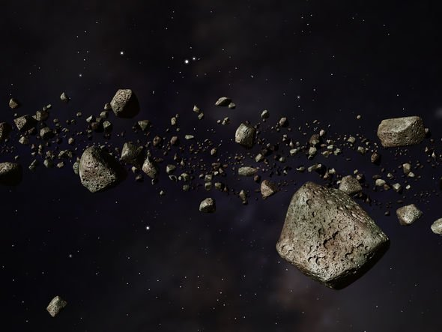
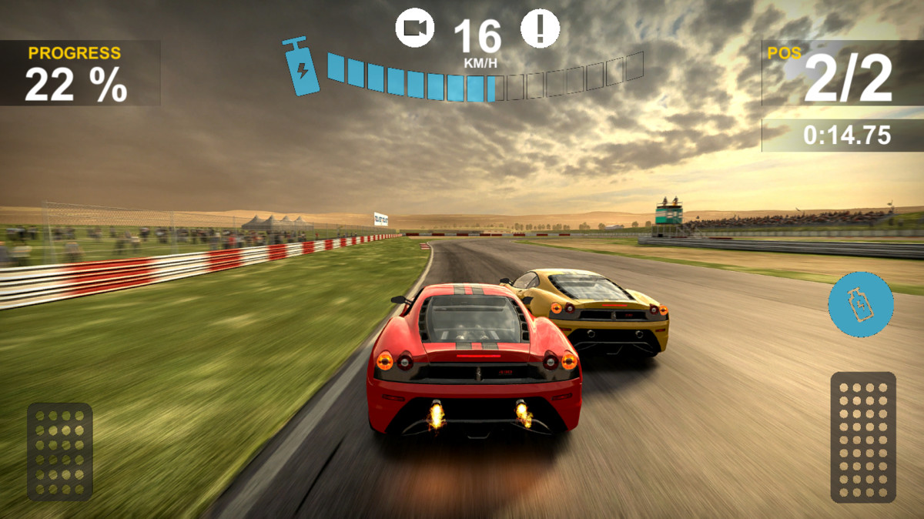
Pillars
Rpg - Leveling system , racing game , winning car system , Terrain is changing.

Slide 4
Gameplay
Leveling up while racing and unlocking new cars , racing on a rainbow road , the map is constantly changing with falling entities.

Slide 5
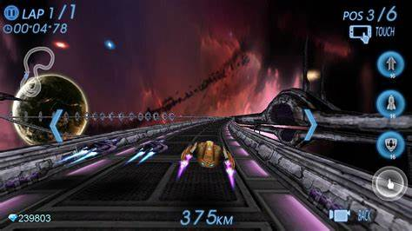
Feature points
Space Role Playing game
Main currency is cars
Main way of getting through the game is getting the best cars
If you lose the race you lose the car

Slide 6


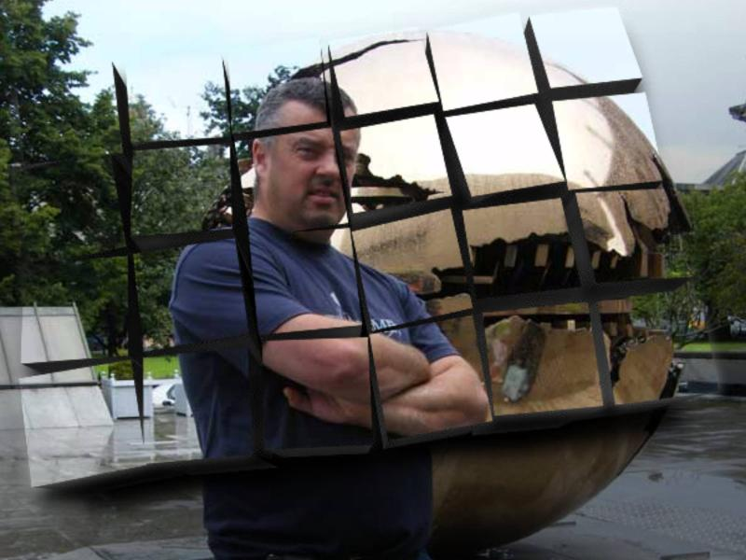
Market Analasis
Similar games: GTA 5, other need for speed games
Typical customer : ages early teen to late 20s
Profit: astronomical profits are estimated

